Slide 1

BASICS OF JAVA
--Nakul J. Khelkar

Slide 2
Contents
Java & Architecture
Setup & Eclipse
Basic Syntax
Object and Classes
Constructors
Basic Datatypes
Variable Types
Modifier Types

Slide 3
What is JAVA?
Java is a programming language and a platform. Java is a high level, robust, object-oriented and secure programming language.
Java was developed by Sun Microsystems (which is now the subsidiary of Oracle) in the year 1995. James Gosling is known as the father of Java. Before Java, its name was Oak. Since Oak was already a registered company, so James Gosling and his team changed the name from Oak to Java.
Platform: Any hardware or software environment in which a program runs, is known as a platform. Since Java has a runtime environment (JRE) and API, it is called a platform.

Slide 4
FEATURES OF JAVA
The primary objective of Java programming language creation was to make it portable, simple and secure programming language. Apart from this, there are also some excellent features which play an important role in the popularity of this language. The features of Java are also known as Java buzzwords.
A list of the most important features of the Java language is given below.
Simple Object-Oriented Portable
Platform independent Secured Robust
Architecture neutral Interpreted High Performance
Multithreaded Distributed Dynamic

Slide 5
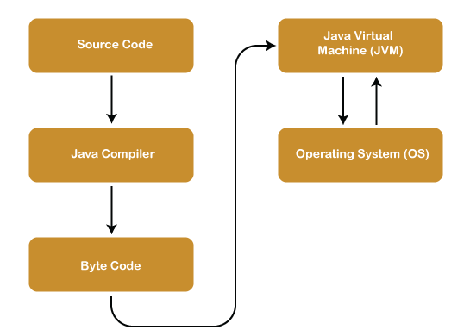
ARCHITECTURE OF JAVA
There are two processes in Java — Compilation and Interpretation.
The Java source code goes to the compiler.
The Java Compiler converts it into byte codes
The bytes codes are then converted into machine by the JVM
The Machine code is executed directly by the OS.

Slide 6
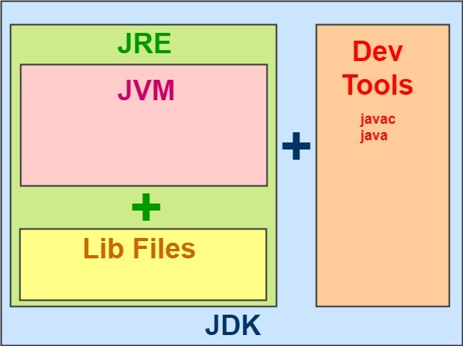
Components of Java Architecture
The different components of Java architecture are:
JRE — Java Runtime Environment
JDK — Java Development Kit
JVM — Java Virtual Machine

Slide 7
Setup and Eclipse
JDK: Java Development kit, is a program which provide the necessary tools to develop and execute a Java program.
Link to Download: Latest Java Version available at Java Downloads | Oracle
Guide to download and install:
https://youtu.be/-5kIt83ldk8 and https://youtu.be/SQykK40fFds
Set path of the jdk/bin directory.
Create the Java program
Compile and run the Java program
.

Slide 8
JAVA BASIC SYNTAX
About Java programs, it is very important to keep in mind the following points.
Case Sensitivity − Java is case sensitive, which means identifier Hello and hello would have different meaning in Java.
Class Names − For all class names the first letter should be in Upper Case. If several words are used to form a name of the class, each inner word's first letter should be in Upper Case.
Example: class MyFirstJavaClass
Method Names − All method names should start with a Lower Case letter. If several words are used to form the name of the method, then each inner word's first letter should be in Upper Case.
Example: public void myMethodName()
Program File Name − Name of the program file should exactly match the class name.
public static void main(String args[]) − Java program processing starts from the main() method which is a mandatory part of every Java program.

Slide 9
CREATING HELLO WORLD EXAMPLE
class Simple {
public static void main(String args[ ])
{
System.out.println ("Hello World");
}
}

Slide 10
OBJECT AND CLASSES IN JAVA
Object − Objects have states and behaviors. Example: A dog has states - color, name, breed as well as behaviors – wagging the tail, barking, eating. An object is an instance of a class.
Class − A class can be defined as a template/blueprint that describes the behavior/state that the object of its type support.
public class Main {
int x = 5;
public static void main(String[] args)
{
Main myObj = new Main();
System.out.println(myObj.x);
}
}

Slide 11
Constructors
A constructor initializes an object when it is created. It has the same name as its class and is syntactically similar to a method. However, constructors have no explicit return type.
Typically, you will use a constructor to give initial values to the instance variables defined by the class, or to perform any other start-up procedures required to create a fully formed object.
All classes have constructors, whether you define one or not, because Java automatically provides a default constructor that initializes all member variables to zero. However, once you define your own constructor, the default constructor is no longer used.
Syntax:
class ClassName {
ClassName( ) {
}
}

Slide 12
BASIC DATATYPES
Variables are nothing but reserved memory locations to store values. This means that when you create a variable you reserve some space in the memory.
Based on the data type of a variable, the operating system allocates memory and decides what can be stored in the reserved memory. Therefore, by assigning different data types to variables, you can store integers, decimals, or characters in these variables.
There are two data types available in Java −
Primitive Data Types
Reference/Object Data Types
Non-primitive data types : The non-primitive data types include Classes, Interfaces, and Arrays.

Slide 13
Primitive Data Type
There are 8 types of primitive data types:
boolean data type
byte data type
char data type
short data type
int data type
long data type
float data type
double data type

Slide 14
VARIABLE TYPES
A variable is a container which holds the value while the Java program is executed. A variable is assigned with a data type. Variable is a name of memory location.
For example:
String - stores text, such as "Hello". String values are surrounded by double quotes
int - stores integers (whole numbers), without decimals, such as 123 or -123
float - stores floating point numbers, with decimals, such as 19.99 or -19.99
char - stores single characters, such as 'a' or 'B'. Char values are surrounded by single quotes
boolean - stores values with two states: true or false
There are three types of variables in Java:
local variable
instance variable
static variable

Slide 15
Local Variable : A variable declared inside the body of the method is called local variable. You can use this variable only within that method and the other methods in the class aren't even aware that the variable exists.
A local variable cannot be defined with "static" keyword.
2) Instance Variable : A variable declared inside the class but outside the body of the method, is called an instance variable. It is not declared as static.
It is called an instance variable because its value is instance-specific and is not shared among instances.
3) Static variable : A variable that is declared as static is called a static variable. It cannot be local. You can create a single copy of the static variable and share it among all the instances of the class. Memory allocation for static variables happens only once when the class is loaded in the memory.

Slide 16
MODIFIER TYPE
Modifiers are keywords that you add to those definitions to change their meanings. Java language has a wide variety of modifiers, including the following −
Java Access Modifiers : - controls the access level
Non Access Modifiers :- do not control access level, but provides other functionality
Ex. public class Main
- The public keyword is an access modifier, meaning that it is used to set the access level for classes, attributes, methods and constructors.

Slide 17
Access Control Modifiers:
Java provides a number of access modifiers to set access levels for classes, variables, methods and constructors. The four access levels are −
Visible to the package, the default. No modifiers are needed.
Visible to the class only (private).
Visible to the world (public).
Visible to the package and all subclasses (protected).
Non-Access Modifiers:
Java provides a number of non-access modifiers to achieve many other functionality.
The static modifier for creating class methods and variables.
The final modifier for finalizing the implementations of classes, methods, and variables.
The abstract modifier for creating abstract classes and methods.
The synchronized and volatile modifiers, which are used for threads.

Slide 18
References:
1.
2.
3.
4.
5.
6.
7.
8.
https://www.w3schools.com/java/default.asp
https://www.javatpoint.com/java-tutorial
https://www.tutorialspoint.com/java/index.htm
https://www.guru99.com/java-platform.html
https://docs.oracle.com/javase/tutorial/
https://youtu.be/BGTx91t8q50
https://youtu.be/UmnCZ7-9yDY
https://youtu.be/j9VNCI9Xo80

Slide 19
TASKS:
Download and Install Java and Java IDE
Write a basic “Hello, World!” JAVA program.
Write a Java program to print the sum of two numbers.
Write a Java program to print 'Hello' on screen and then print your name on a separate line.
Write a Java program to divide two numbers and print on the screen.
Write a Java program that takes two numbers as input and display the product of two numbers.
Write a Java program to print the sum (addition), multiply, subtract, divide and remainder of two numbers.
Write a Java program that takes three numbers as input to calculate and print the average of the numbers.

Slide 20
THANK YOU

